Slide 1
Prof. dr. Maja Godina Golija
ZRC SAZU /Scientific Research Centre of Slovenian Academy of Sciences and Arts/ and University of Maribor
Food Expenditure and Nutrition in Slovenia 1920-2015

Slide 2
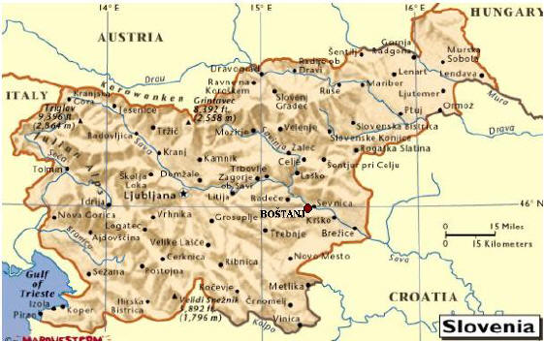


Slide 3
At the beginning of the 20th century Slovenia was predominantly an agrarian country:
in 1921 66% of Slovenes worked in agriculture in 1931 59.5% of Slovenes worked in agriculture
in 1940 50% of Slovenes worked in agriculture
in 1971 19% of Slovenes worked in agriculture
in 1991 8.8% of Slovenes worked in agriculture
in 2015 4.5% of Slovenes worked in agriculture

Slide 4
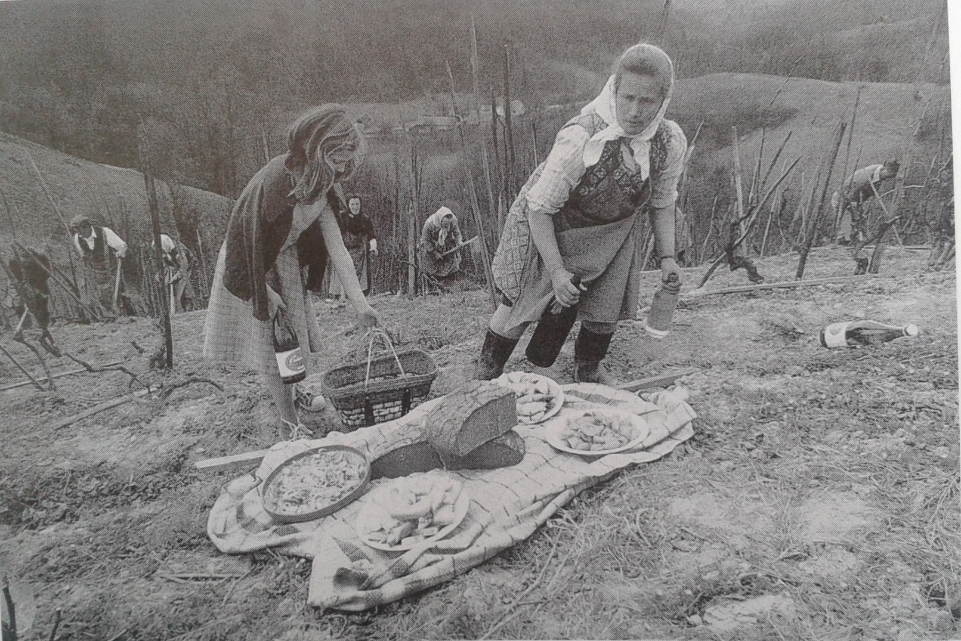

Slide 5
Generally self-sufficient, Slovene farmers worked the land for their own household needs, to feed their families and less to market their crops.
They provided a variety of produce typical for the geographically diverse regions that make up Slovenia.
A gradual industrialization after the First World War somewhat changed this situation.

Slide 6
Four mayor types of traditional food culture in Slovenia:
According to ethnological classification, there are four major types of food culture in Slovenia:
the Pannonian type
the Alpine type
the Central type
the Mediterranean type

Slide 7
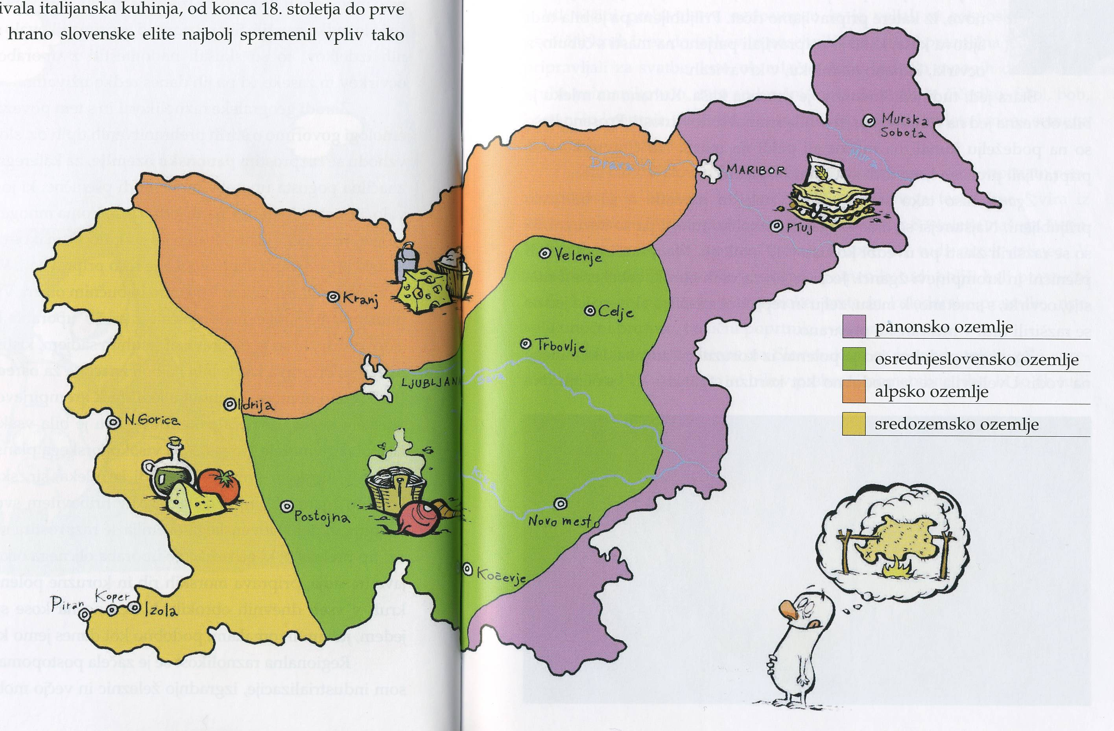

Slide 8
The working-class
family (1936):
10 kg of bread flour 3 kg of maize groats 10 kg of bread flour 1.3 kg of beef
0 kg of veal 0 kg of pork 9 litres of milk 6 eggs 1 kg of sugar
The middle-class urban family (1936):
12 kg of white flour 1 kg of maize groats 12 kg of white flour 1.80 kg of beef 0.90 kg of veal 0.80 kg of pork 15 litres of milk 14 eggs 1.80 kg of sugar

Slide 9
Slovene family bought the following amount of food per month:
1936
13 kilograms flour and groats
2.45 kg meat
12 l of milk
10 eggs
1.4 kg sugar
1954
31.1 kg flour and groats
6.8 kg meat
33.7 l of milk
30 eggs
5.3 kg sugar

Slide 10
% of the average yearly income were spent on food:
1936 63.2%
1953 46.6%
1968 50.38%
1972 50.51%
2002 17.4%
2014 14%

